Slide 1


Implementing a
Trauma-Informed Approach for Youth Across Service Sectors
Tuesday, May 21, 2013
American Institutes for Research®

Slide 2
Webinar Agenda
Larke Nahme Huang, Ph.D.: Welcome and Introductions; Developing SAMHSA’s Framework for Trauma
NC: An overview of his lived experience in out-of-home care and his role as a peer specialist
Gene Griffin, J.D., Ph.D.: Trauma and the Three E’s
Julian D. Ford, Ph.D.: Helping Children (and Families and Communities) Recover from Trauma
Charles Wilson: The Emergence of Trauma- Informed Child Welfare Systems
LS: An overview of her experience in foster care and her journey to becoming a law student, community advocate, and public speaker
Question and Answer

Slide 3


Polling Question #1
Notes:
Please indicate in which service sector you work:
Mental health
Substance abuse
Child welfare
Juvenile justice
Education
Primary care Health Care
Specialty Health Care
Hospital-based Care
Housing
Labor
Defense
National Guard
National and Community Service
Homeless
Domestic Violence
Other

Slide 4
Welcome and Introductions
Larke Nahme Huang, Ph.D.
Lead for the Trauma and Justice Strategic Initiative
Administrator’s Office of Policy Planning and Innovation
Substance Abuse and Mental Health Services Administration
Implementing a
Trauma-Informed Approach for Youth
Across Service Sectors
Tuesday, May 21, 2013

Slide 5
SAMHSA’s Trauma and Justice Strategic Initiative
Integrating a trauma informed approach throughout health, behavioral health and related systems in order to reduce the harmful effects of trauma and violence on individuals, families and communities.
Utilizing innovative strategies to reduce the involvement of individuals with trauma and behavioral health issues in the criminal and juvenile justice systems.

Slide 6
Developing SAMHSA’s Framework for Trauma

Slide 7
SAMHSA’s – Experts Panel, Concept Development & Public Comment
Trauma and Trauma-Informed Care Experts Panel (May, 2012)
25 national experts, representing research, practice, policy and trauma survivors
Concept/Framework:
  Experts’ Working Definitions of Individual Trauma and Trauma-Informed Approach
  Core Values and Principles of Trauma-Informed Approach
  Guidelines for Developing a Trauma-Informed Approach
  Preliminary discussion on the definition of community trauma
Public Comment (December, 2012) Online posting; >2,000 respondents; 20,000 comments or endorsements

Slide 8
SAMHSA’s Concept of a
Trauma-Informed Approach (draft)
A program, organization or system that is trauma-informed:
realizes the widespread impact of trauma and understands potential paths for recovery;
recognizes the signs and symptoms of trauma in clients, families, staff, and others involved with the system;
resists retraumatization, and
responds by fully integrating knowledge about trauma into policies, procedures, practices, and settings.

Slide 9
Principles of a
Trauma-Informed Approach
(Fallot & Harris, draft)
Safety: throughout the organization, staff and the people they serve feel physically and psychologically safe; the physical setting is safe and interpersonal interactions promote a sense of safety.
Trustworthiness and transparency: organizational operations and decisions are conducted with transparency and the goal of building and maintaining trust among clients, family members, staff, and others involved with the organization. Trauma-informed peer support and mutual self-help are key vehicles for establishing safety, building trust, enhancing collaboration, and maximizing empowerment.
Collaboration and mutuality: there is true partnering and leveling of power differences between staff and clients and among organizational staff from direct care staff to administrators; there is recognition that healing happens in relationships and in the meaningful sharing of power and decision-making. The organization recognizes that everyone has a role to play in a trauma-informed approach; one does not have to be a therapist to be therapeutic.
Empowerment: throughout the organization and among the clients served, individuals’ strengths are recognized, built on, and validated and new skills developed as necessary. The organization fosters a belief in resilience and in the ability of individuals, organizations, and communities to heal and promote recovery from trauma; builds on what clients, staff and communities have to offer rather than responding to their perceived deficits.
Voice and choice: the organization aims to strengthen the clients’, family members’, and staff’s experience of choice and recognize that every person’s experience is unique and requires an individualized approach. The organization addresses cultural, historical, and gender issues; the
organization actively moves past cultural stereotypes and biases, offers gender responsive
services, Promotes the value of cultural connections, and recognizes and addresses historical trauma.

Slide 10
NC
19 years old
Enjoys writing music and drawing
Lived in Out-of-Home Care for over 5 years, of which three years were in foster care
Received child welfare services for over 6 years
Received independent living services throughout life
Completed a training course to become a peer specialist
Currently working as a peer specialist

Slide 11
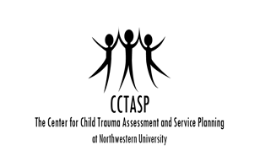
Trauma and the Three E’s
Gene Griffin, J.D., Ph.D.
Northwestern University
Feinberg School of Medicine
May 21,2013

Slide 12
What Do We Mean by Trauma?
Multiple Definitions
Framework for Understanding:
  Event
  Experience
  Effects
“Three E’s”

Slide 13
Trauma- Events (E1)
Objective and Measurable
  Abuse- Physical, Emotional, Sexual
  Domestic / Community Violence
  Accident / Natural Disaster
  War / Terrorism
Issues
  Less Intense but Chronic Events
  Neglect
  Illness of Caregiver
  Removal from Home

Slide 14
Trauma- Experiences (E2)
Subjective and Difficult to Measure
  ‘Life Threatening or Overwhelming’
  Varies Between People
  Varies Over Time with the Same Person
Useful in Explaining Why Most People Have ‘Event’ but No ‘Effect’
  Resilience
  Protective Factors
Issues
  “Experience” is Often Confounded with “Event”
  Not Clear What Level of Emotional Arousal is Required or When It Must Occur

Slide 15
Trauma- Effects (E3)
Classic Symptoms include:
  Re-experiencing (Nightmares or Flashbacks)
  Hyperarousal (Overreactive, Hypervigilant)
  Avoidance (Fight, Flight, or Freeze)
Issues
  Trauma > PTSD
  Long-term Outcomes
    Adverse Childhood Experiences Study (ACES)
    Brain Development
    Stress Response
    Epigenetics

Slide 16
Sample Trauma Definitions
The experience [E2] of an event [E1] by a child that is emotionally painful or distressful which results in lasting mental and physical effects [E3]. -NIMH
Traumatic stress occurs when an extreme experience [E1] overwhelms [E2] and alters [E3] the individual’s stress-­‐related physiological systems in a way that results in functional compromise in any of the widely distributed stress-­‐response systems (e.g., neuroimmune, neuroendocrine, autonomic and central nervous system networks). -Ungar & Perry

Slide 17
Posttraumatic Stress Disorder
PTSD (DSM- IV-TR)
A(1).The person experienced, witnessed, or was confronted with an event or events that involved actual or threatened death or serious injury, or a threat to the physical integrity of self or others. [E1]
A(2). The person's response involved intense fear, helplessness, or horror. [E2]
B. Re-experiencing Symptoms… [E3]
C. Avoidant/Numbing Symptoms…
D. Hyperarousal Symptoms…

Slide 18
Posttraumatic Stress Disorder
(DSM-5 Proposed)
A. The person was exposed to the following event(s): death or threatened death, actual or threatened serious injury, or actual or threatened sexual violation… [E1]
[Eliminates A(2)]
B. Re-experiencing [E3]
C. Avoidance
D. Negative alterations in cognitions and mood that are associated with the traumatic event(s) (that began or worsened after the traumatic event(s)) [E2]
E. Arousal
Notes:
Review
DEPRESSION AND ANXIETY 0 : 1–20 (2010)
CONSIDERING PTSD FOR DSM-5
Matthew J. Friedman, M.D. Ph.D.,1,2! Patricia A. Resick, Ph.D.,1,3,4 Richard A. Bryant,5 and Chris R. Brewin6
(A) The person was exposed to the following
event(s): death or threatened death, actual or threatened
serious injury, or actual or threatened sexual
violation, in one or more of the following ways:
(1) Experiencing the event(s) him/herself.
(2) Witnessing the event(s) as they occurred to others.
(3) Learning that the event(s) occurred to a close
relative or close friend.
(4) Experiencing repeated or extreme exposure to
aversive details of the event(s) (e.g. first responders
collecting body parts; police officers repeatedly
exposed to details of child abuse).
Posttraumatic Stress Disorder, American Psychiatric Association 2013

Slide 19
“Trauma”
PTSD Cluster
Trauma Effects
Trauma Events
Complexity

Slide 20
Trauma in Child Welfare Per 1000 Children (Illinois Data, N>14,000)
Notes:
Griffin et al, 2011

Slide 21
Helping Children (and Families and Communities) Recover from Trauma
Julian D. Ford
University of Connecticut School of Medicine
jford@uchc.edu
Notes:
*Unless otherwise arranged, Regina and Joe should be next to last and last author on every webinar presentation in this series.

Slide 22
Trauma Often Strikes Twice (or more often): 1 in 5 American Children are Poly-victims
Poly-victimization: exposure to multiple types of traumatic victimization
  Nationally representative sample of 2,030 U.S. children, 22% had 4+ types of victimization in past year (Finkelhor, Ormrod, and Turner, 2007)
  Nationally representative sample of 3351 U.S. teens, 8-17% had on average 5-10 (of 24) types of victimization lifetime (Ford, Elhai, Connor, & Frueh, 2010)
Notes:
References:
Finkelhor, D., Ormrod, R., & Turner, H. (2007) Polyvictimization: a neglected component of child victimization, Child Abuse and Neglect, 31, 7-26.
Finkelhor, D., Ormrod, R., Turner, H., & Holt, M. (2009). Pathways to poly-victimization. Child Maltreatment, 14(4), 316-329.
Finkelhor, D., Ormrod, R. K., & Turner, H. A. (2009). Lifetime assessment of poly-victimization in a national sample of children and youth. Child Abuse & Neglect, 33(7), 403-411.
Turner, H. A., Finkelhor, D., & Ormrod, R. (2010). Poly-victimization in a national sample of children and youth. American Journal of Preventive Medicine, 38, 323–330.
Ford, J. D., Elhai, J. D., Connor, D. F., & Frueh, B. C. (2010). Poly-victimization and risk of posttraumatic, depressive, and substance use disorders and involvement in delinquency in a national sample of adolescents. Journal of Adolescent Health, 46, 545-552.

Slide 23
As Many as Half of All Children in the Mental Health, Child Welfare, and Juvenile Justice Systems are Poly-victims
  397 children in residential treatment: 52% had histories of abuse AND impaired caregivers AND multiple out-of-home placements (Ford, Connor, & Hawke, 2009)
  1959 youth in juvenile detention: 41% were poly-victims – having experienced on average, 9-11 types of potentially traumatic victimization (Ford, Grasso, & Hawke, in press)
Notes:
References:
Ford, J. D., Connor, D. F., & Hawke, J. (2009). Complex trauma among psychiatrically impaired children. Journal of Clinical Psychiatry, 70, 1155-1163.
Ford, J. D., Grasso, D., Hawke, J., & Chapman, J. (in press). Poly-victimization among juvenile justice-involved youths. Child Abuse & Neglect

Slide 24
The Common Denominator in the Emotional/Behavioral/Social and Learning Problems of Poly-victimization
Chronic Survival Coping
Hypervigilance (Distrustful/On Edge)
Reactive Aggression (Overt or Covert)
Hopelessness Masked as Indifference

Slide 25
Posttraumatic Survival Coping – A Learning Brain Shifts into Survival Mode
Can’t stop and think, or think past the immediate problem or threat
Can’t let go of grudges/resentments
Can’t set/stick with goals
Can’t trust, especially caregivers
Can’t tell who is trustworthy
Can’t remember to use anger management skills, especially when very angry!

Slide 26
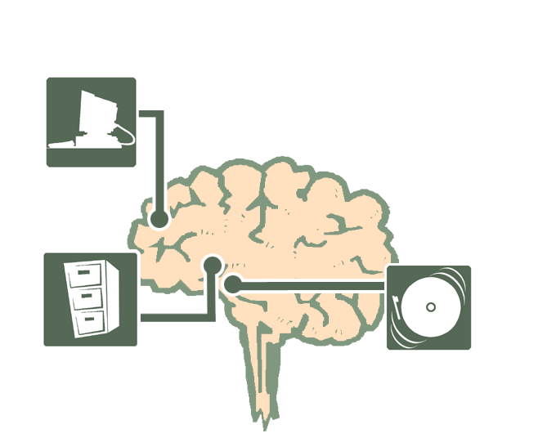
The Brain Under Normal Stress
Copyright © 2001 by the University of Connecticut All rights reserved.
No part of this work may be copied or distributed without prior written permission.

Slide 27

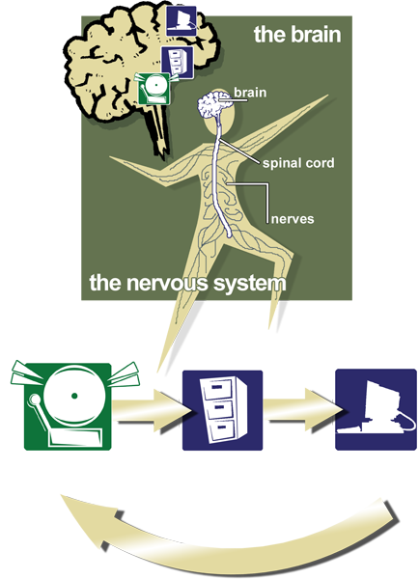
Normal Stress, The Brain & Body Working Together
Copyright © 2001 by the University of Connecticut
All rights reserved.
No part of this work may be copied or distributed without prior written permission.

Slide 28
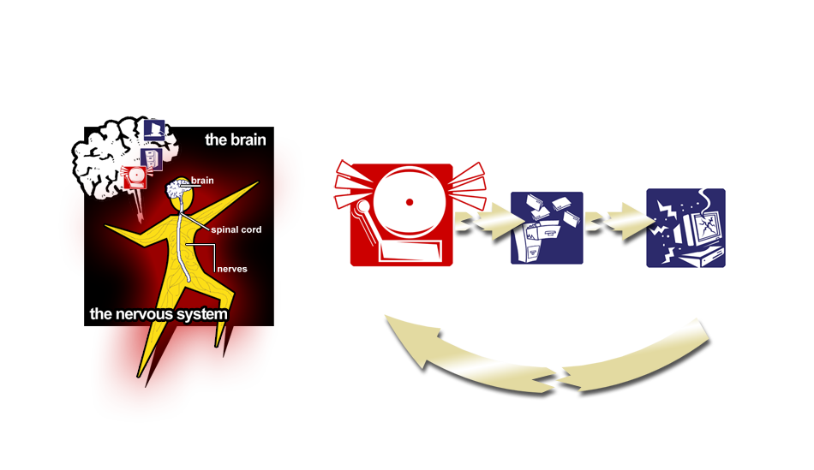
Extreme Stress / Trauma, The Alarm Takes Control
Copyright © 2001 by the University of Connecticut All rights reserved.
No part of this work may be copied or distributed without prior written permission.

Slide 29
The Goal of Recovery from Trauma: Tapping Into the Mind’s Ability to Re-set the Brain’s Alarm
Everyone has an alarm in their brain to keep us safe and alert. The alarm must be re-set when activated so that extreme (post-traumatic) alarm reactions don’t happen when they’re not needed.
Evidence-based therapy/programs for trauma recovery help youth/caregivers tap into their strengths to learn how to focus their minds.
The TARGET model’s SOS is one example.

Slide 30

Peanuts Classics ®

Slide 31


SOS: Three Steps to Focusing
Step I: Slow Down
  Step back, sweep your mind clear
Step II: Orient
  Choose ONE thought (words or pictures): whatever is most important and positive in your life right now
Step III: Self Check
Copyright © 2001 by the University of Connecticut All rights reserved.
No part of this work may be copied or distributed without prior written permission.

Slide 32
The Key to Trauma Recovery: Making a Contribution
The greatest contribution a person can make is to live all day, every day in a truly focused way:
  Recognizing your own and others’ alarm reactions
  Sweeping your mind clear before judging/acting
  Focusing on what’s most important and positive
  Being aware of stress AND personal control levels
  This activates the Thinking Center and re-sets the Alarm
Notes:
For those with a strong spiritual base, this step is perfect to incorporate beliefs in God, religion, etc.

Slide 33
Many Paths to Recovery: Evidence-Based Models
  Cognitive-behavioral therapies
  Emotion regulation therapies
  Relational-interpersonal therapies
  Psychotherapies for dissociation
  Parent-child and family system therapies
  Social/helping network therapies
  Peer-to-peer support programs
Notes:
For those with a strong spiritual base, this step is perfect to incorporate beliefs in God, religion, etc.

Slide 34
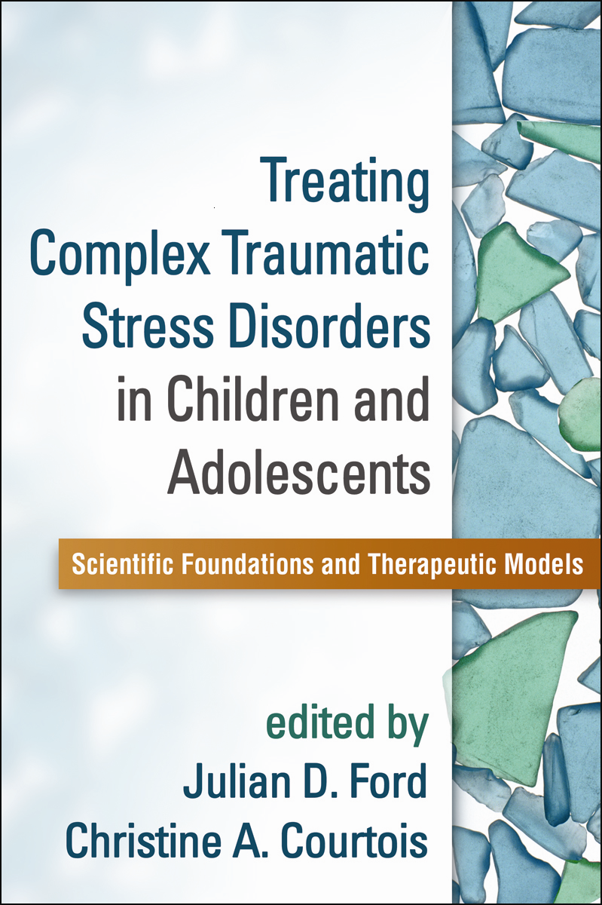
Treating Complex Traumatic Stress Disorders in Children and Adolescents

Slide 35
The Emergence of Trauma- Informed Child Welfare Systems
Charles Wilson
Chadwick Center for Children and Families
Rady Children’s Hospital - San Diego, California
Co-Principal Investigator
SAMHSA - Chadwick Trauma Informed Systems –
DI Project

Slide 36
Emotional Chain of Custody

Slide 37
What Makes up a Trauma Informed Child Welfare System?
Broader Child-Serving System Factors
Child Welfare System Factors
Family Factors
Individual Factors
The systems can make it better or make it worse
The caregivers play a central role in Recovery
Help the child tap their
natural resiliency and give
them new tools for
managing the stress

Slide 38
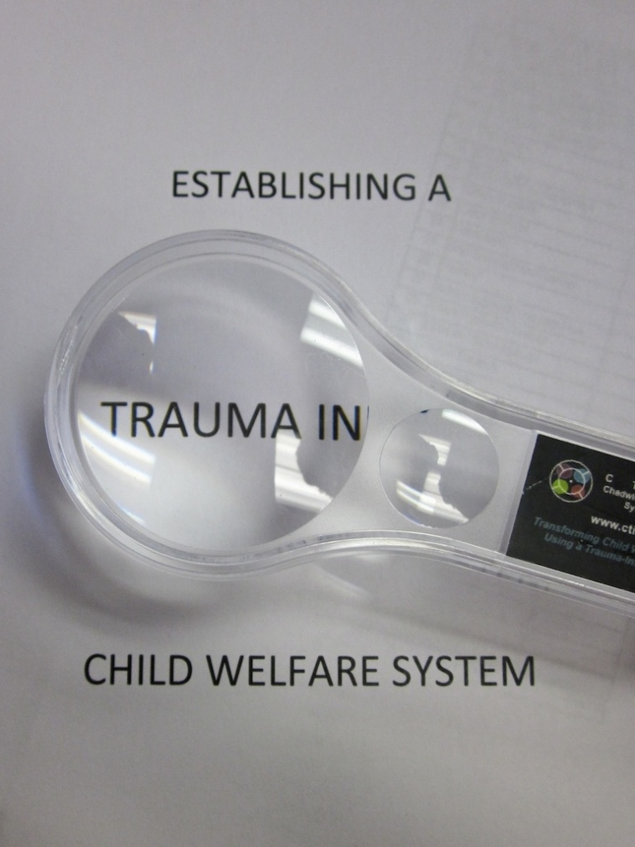
Seeing Through a Trauma Lens

Slide 39
Definition of Trauma-
Informed System
A trauma-informed child welfare system is one in which all parties involved recognize and respond to the varying impact of traumatic stress on children, caregivers and those who have contact with the system. Programs and organizations within the system infuse this knowledge, awareness and skills into their organizational cultures, policies, and practices. They act in collaboration, using the best available science, to facilitate and support resiliency and recovery.
- CTISP National Advisory Committee

Slide 40
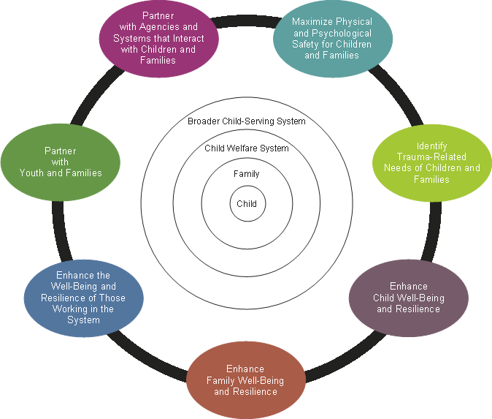
Essential Elements of a Trauma-
Informed Child Welfare System

Slide 41
Element #1: Maximize Physical and Psychological Safety for Children and Families
Safety is one of the priorities of the child welfare system – but for a child and family who have experienced trauma, they may still feel unsafe even when they are no longer in a dangerous situation. Given this, in addition to ensuring physical safety, it is important to help children and families feel psychologically safe.
Maximize Physical and Psychological Safety for Children and Families
Notes:
Send updated slide – Original slide 113

Slide 42
Key Terms in Thinking About Psychological Safety
Trauma Reminder
“The child’s memory retains those learned links, and such thoughts and memories are sufficient to elicit ongoing fear and make a child anxious” - National Scientific Council on the Developing Child (2010)
Trauma Trigger

Slide 43
Element #2: Identify Trauma-Related Needs of Children Families
One of the first steps in helping trauma-exposed children and families is to understand how they have been impacted by trauma
Trauma-related needs can be identified through trauma screening and assessment
It is important to consider trauma when making service referrals and service plans
Identify Trauma-Related Needs of Children and Families

Slide 44
Element #3: Enhance Child
Well-Being and Resilience
Many children are naturally resilient
It is important for the child welfare system to recognize and build on children’s existing strengths
Both individual caseworkers and overall agency policies should support the continuity of children’s relationships
Child welfare staff and agencies should also ensure that children who have been traumatized have access to evidence-based trauma treatments and services
Enhance Child Well-Being and Resilience

Slide 45
Element #4: Enhance Family Well-Being and Resilience
Enhance Family Well-Being and Resilience
Families are a critical part of both protecting children from harm and enhancing their natural resilience
Providing trauma-informed education and services to parents and other caregivers enhances their protective capacities
Child welfare agencies should recognize that caregivers themselves may have trauma histories
Notes:
welfare agencies should recognize that caregivers themselves may have trauma histories

Slide 46
Element #5 - Enhance the Well-Being and Resilience of Those Working in the System
While child welfare staff play an important role in supporting children, working with people that have experienced abuse, neglect, violence, and other trauma can cause staff to develop secondary traumatic stress reactions
Child welfare agencies should collect information about trauma and secondary trauma experienced by staff, implement strategies and practices that build resilience and help staff manage stress, and address the impact of secondary traumatic stress on both individuals and on the system as a whole
Enhance the Well-Being and Resilience of Those Working in the System
Notes:
Send updated slide – original slide 188

Slide 47
Element #6: Partner with Youth and Families
Youth and families should be given choices and an active voice in decision-making on an individual, agency, and systemic level
Youth and family members who have been in the system have a unique perspective and can provide valuable feedback
Partnerships with youth and families should occur at all levels of the organization
Partner with Youth and Families
Notes:
Send updated slide – original 198

Slide 48
Element #7: Partner with Agencies and Systems that Interact with Children and Families
Child welfare agencies need to establish strong partnerships with other child- and family-serving systems
Service providers should develop common protocols and frameworks
Cross-system collaboration enables all helping professionals to see the child as a whole person, thus preventing potentially competing priorities and messages
Collaboration between the child welfare and mental health systems promotes cohesive care and better outcomes
Partner with Agencies and Systems that Interact with Children and Families
Notes:
Send updated slide – original slide 208

Slide 49

Levels of Implementation
Paper
Process
Performance
  Real organic organizational change at the cultural level
Fixsen, D., Naoosm, S., Blasé,
K., Friedman, R., Wallace, F. (2005)
http://nirn.fmhi.usf.edu
Notes:
Paper implementation means putting into place new policies and procedures (the "recorded theory of change," Hernandez & Hodges, 2003) with the adoption of an innovation as the rationale for the policies and procedures.
One estimate was that 80-90% of the people-dependent innovations in business stop at paper implementation (Rogers, 2002).
Process implementation means putting new operating procedures in place to conduct training workshops, provide supervision, change information reporting forms, and so on (the "expressed theory of change" and "active theory of change," Hernandez & Hodges, 2003) with the adoption of an innovation as the rationale for the procedures.
Performance implementation means putting procedures and processes in place in such a way that the identified functional components of change are used with good effect for consumers (the "integrated theory of change," Hernandez & Hodges, 2003; Paine, Bellamy, & Wilcox, 1984). It appears that implementation that produces actual benefits to consumers, organizations, and systems requires more careful and thoughtful efforts.

Slide 50
LS
Third-year law student
Community advocate and public speaker
Holds a B.S. in Healthcare Administration and a B.A. in Psychology
Is among the less than 3% of foster care alumni to complete a college degree
Entered foster care at age 7 along with two siblings. They were immediately separated. She spent the next 11 years moving from home to home and school to school. Experienced a failed adoption at age 16 that motivated her to seek independence. At age 17, she began working and enrolled in college

Slide 51

Q & A Session

Slide 52
We encourage you to provide feedback on today’s webinar by sending an email to:
FindYouthInfo@air.org

